Slide 1

PROJECT TITLE : CADDESK PORTAL
SUBMITTED TO : PRUTHVI RAJ SINGH
SUMBITTED FROM : MEGHANA

Slide 2
OBJECTIVE :
HTML allows users to mark program elements using tags, allowing a web browser to distinguish between features, such as separating the title of this section and the bulleted text. CSS gives stylistic information to a web browser, indicating, for example, what size and font this text should be displayed.

Slide 3
EXPLANATION :
HTML and CSS are two languages that work together to create everything that you see when you look at something on the internet. HTML is the raw data that a webpage is built out of. All the text, links, cards, lists, and buttons are created in HTML. CSS is what adds style to those plain elements.

Slide 4
Technology used in Project :
What is HTML ?
HTML stands for Hyper Text Markup Language. HTML is the standard markup language for creating Web pages. HTML describes the structure of a Web page. HTML consists of a series of elements. HTML elements tell the browser how to display the content.
What is CSS ?
CSS (Cascading Style Sheets) is used to style and layout web pages — for example, to alter the font, color, size, and spacing of your content, split it into multiple columns, or add animations and other decorative features.

Slide 5
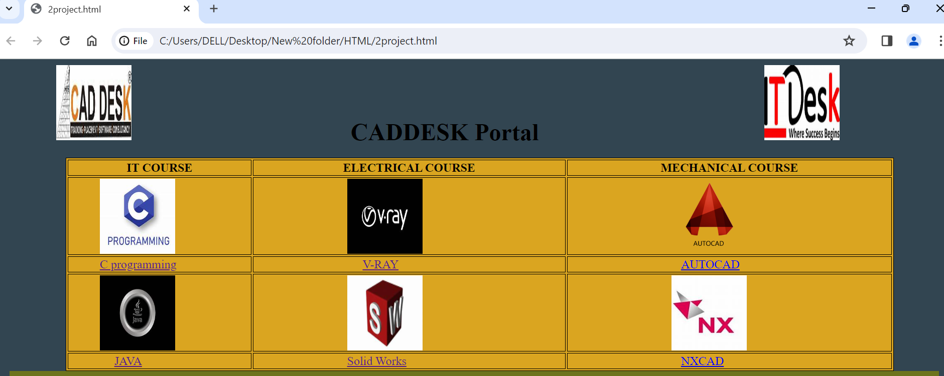

Slide 6


Slide 7
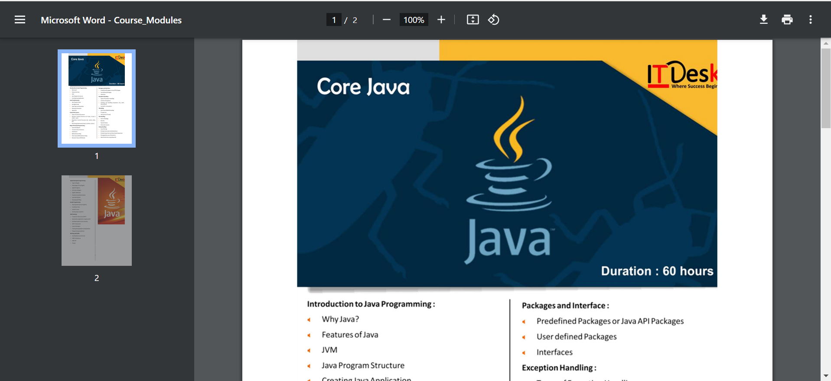

Slide 8
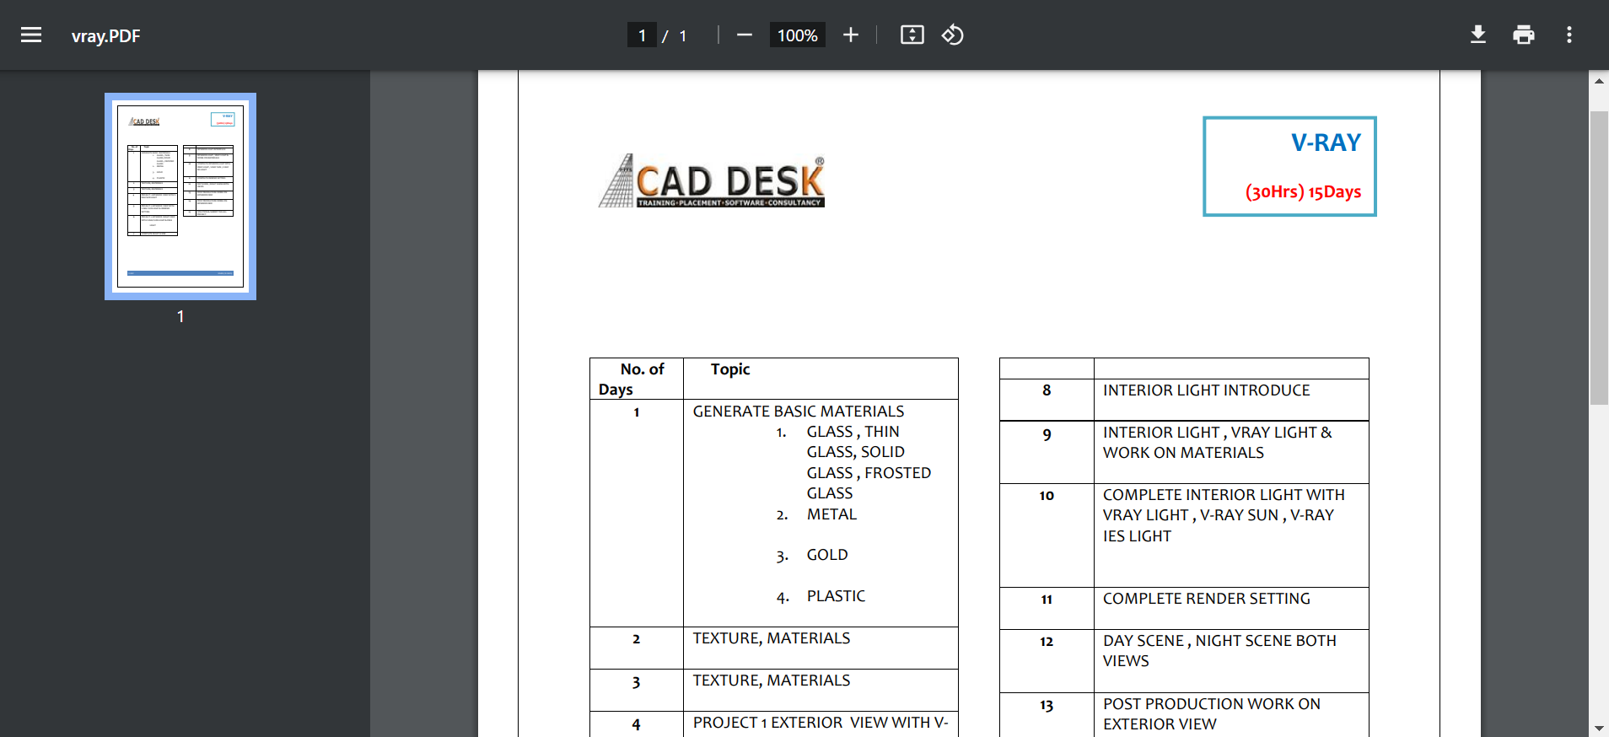

Slide 9
Conclusion :
HTML and CSS are not programming languages in the traditional sense but are critical components of web development. HTML structures and provides meaning to content, while CSS adds visual styles and layout. Together, they form the foundation for building captivating and user-friendly websites.

Slide 10
References :
https://caddeskbangalore-bommanhalli.com/

Slide 11
THANK YOU
NAME : A.MEGHANA
COURSE : JAVA FULL STACK

